Slide 1
ADOBE SIGN and a/C transmittal form process
Norco college
Presenters:
Esmeralda Abejar, Director, College Business Services
Lenny Riley, Instructional Technology Specialist
Ana Molina, Accounting Services Clerk

Slide 2

Adobe sign

Slide 3
What is Adobe sign?
Adobe Sign is designed to route an agreement/contract electronically for legally binding digital signatures.
Norco college will be utilizing Adobe Sign to collect signatures on Human Resources forms, Payroll forms, Budget forms and some Purchasing Forms and accounting forms.
Important things to remember:
It is important to set up the order of signers/recipients accurately since the beginning.
And add all required signers of the form when setting up approvers.
Assign roles to signers
Assign fields to signers.

Slide 4
Benefits of using adobe sign
After signers are set up, signature process routes automatically.
Reminders for signers can be added to the form.
Initiator can easily check the status of the approval and follow up with signer.
When form is completed, an e-mail from FCCC - Riverside CCD <echosign@echosign.com> is received by all parties included in the approval flow.
Initiator can find all the forms in Adobe sign and see the status.
Signers can also see what forms they have signed and which ones are pending signatures.

Slide 5
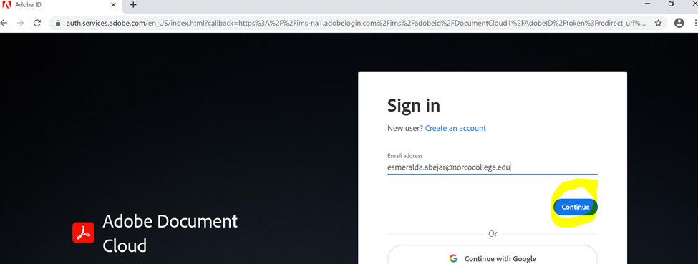
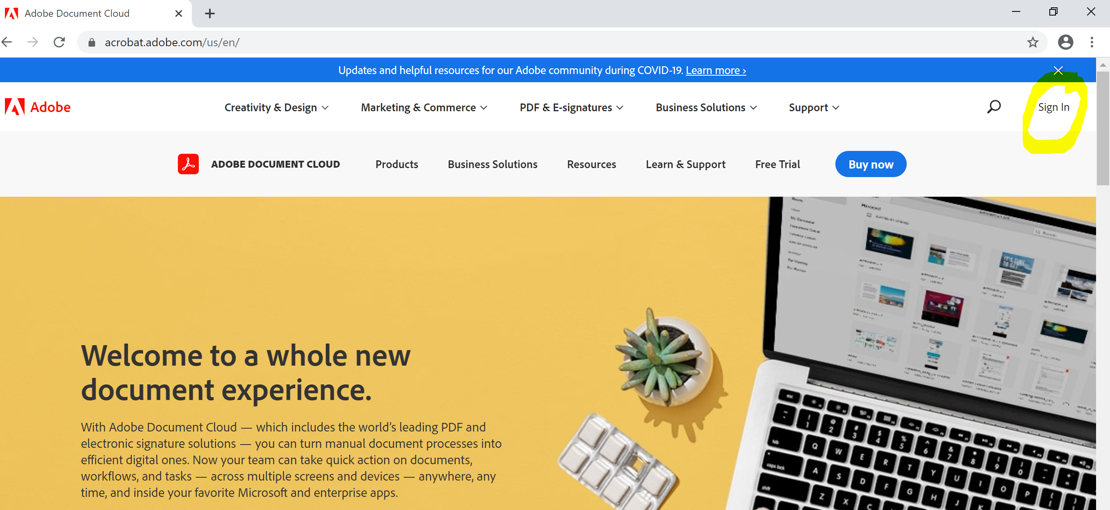
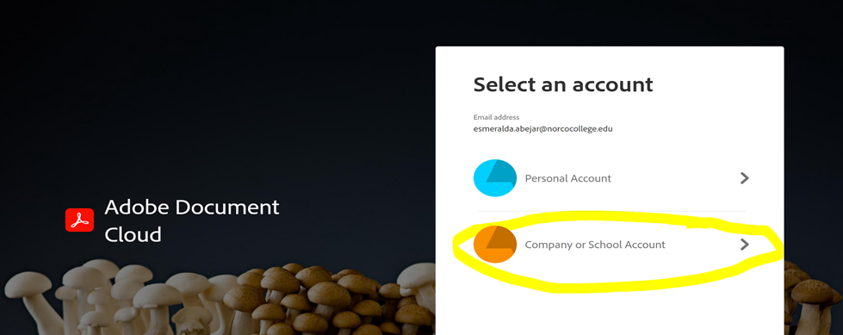
How to use adobe sign
Sign in with your college e-mail address and hit continue
Go to www.adobe.com/documents
Click Sign In.
Click Company or School Account

Slide 6
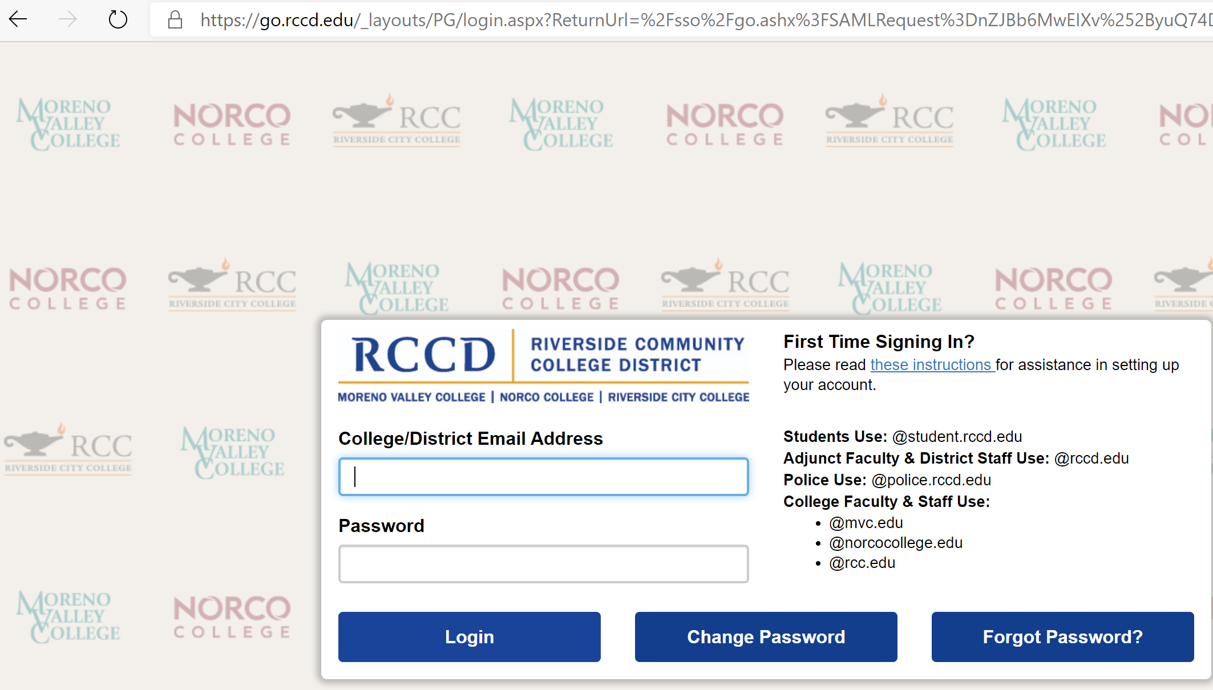
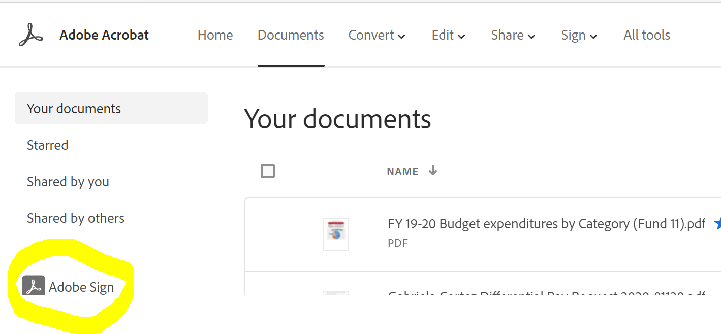
How to use adobe sign
You will be directed to the RCCD network
Click on Adobe Sign,

Slide 7
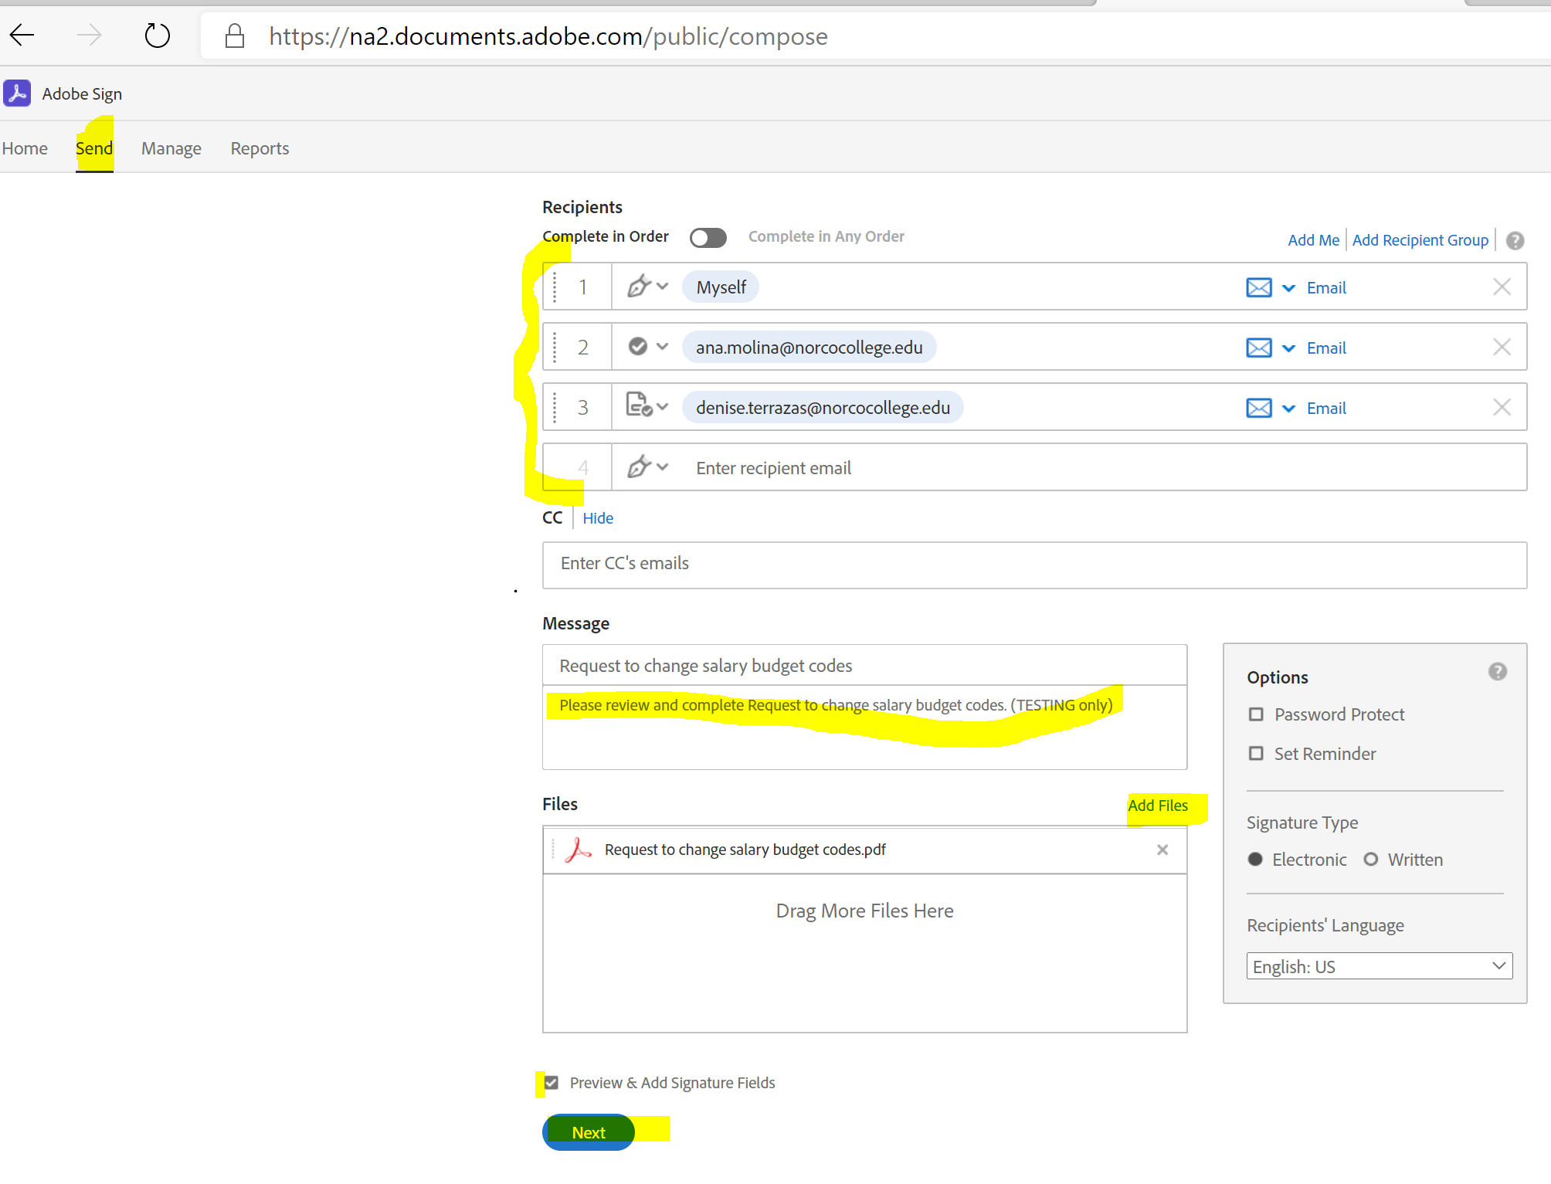
How to use adobe sign continues
1. Click Send
4. Assign Signers Roll
2. Add files
Optional: password protect and set reminder
* 3. Enter Recipients e-mails in order
A recipient that is copied can’t sign/initial documents
5. Update default message as needed.
6. Check box and click next
* Include all required signers on the form when setting Adobe sign.

Slide 8
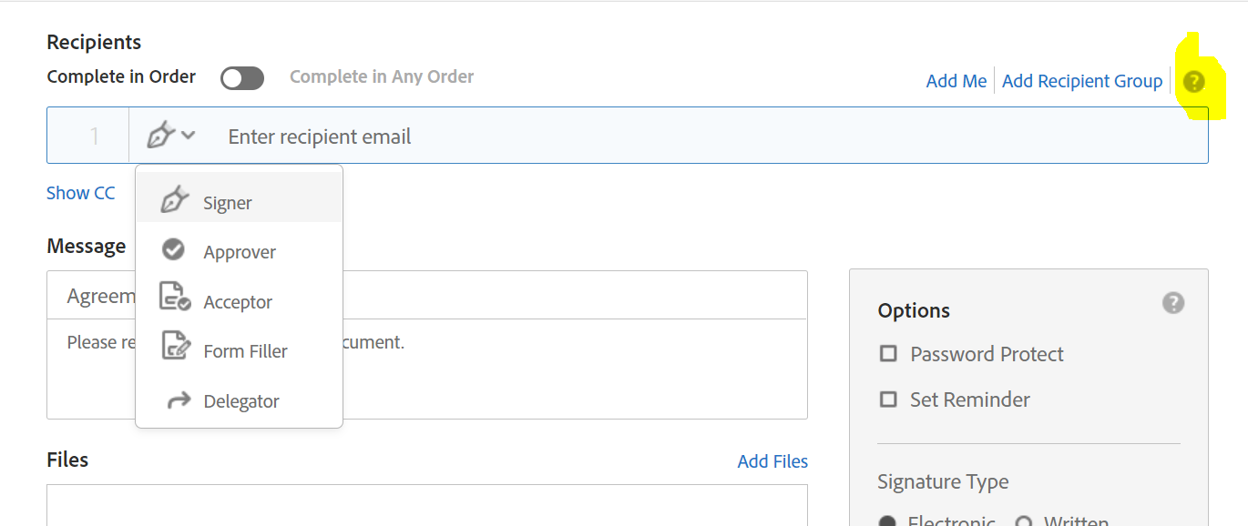
SIGNERS ROLES
Roles: In addition to designating recipients as Signers, you can mark them as Approvers or Form Fillers, Acceptors or Delegators
Approver: Recipient marked as approvers review and approve the document but they are not required to sign it. They may be required to enter data into fields.
Form Filler: Recipients marked as form fillers are required to enter data into the form fields and submit the document
Acceptor: Recipients marked as acceptors are required to accept the document. They may be required to enter data in to fields.
Delegator: Recipient marked as delegators may review the document but can’t sign. Approve or accept the document or acknowledge its receipt. They need to forward the document to another user who may take the appropriate action.

Slide 9
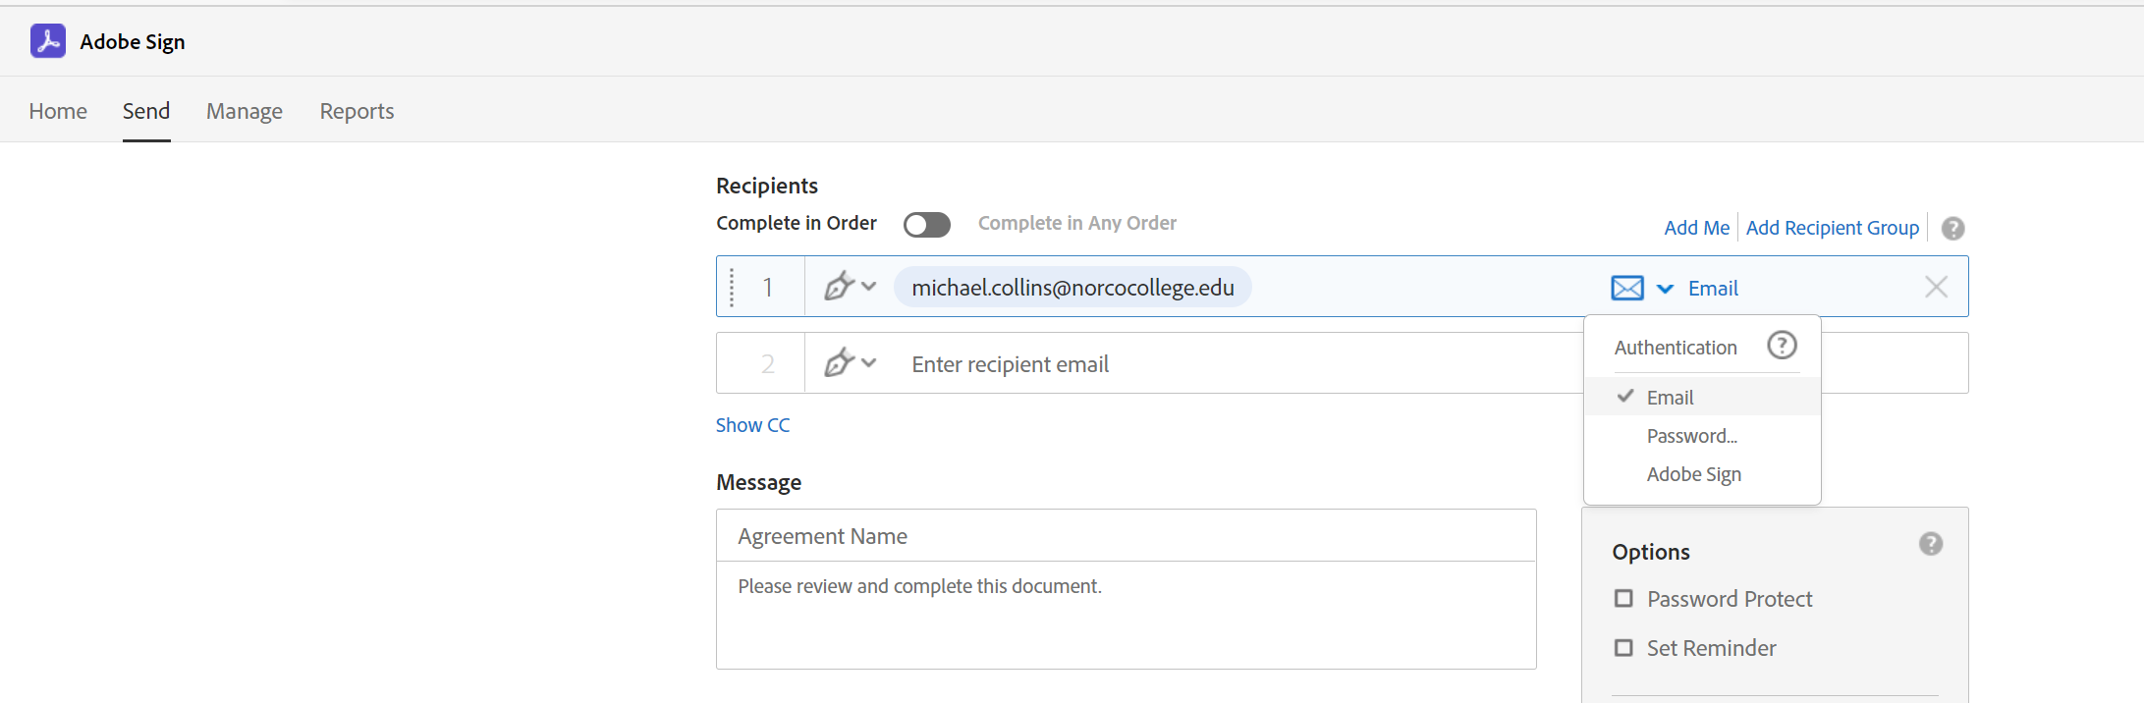
AUTHENTICATION
To increase security in the approval process, it is recommended that Adobe Sign is selected for authentication purposes when using the form internally within RCCD .
When forms are being sent to vendors outside the District, you can use the e-mail or set up a password for authentication purposes since they might not have an Adobe Sign account set up.

Slide 10
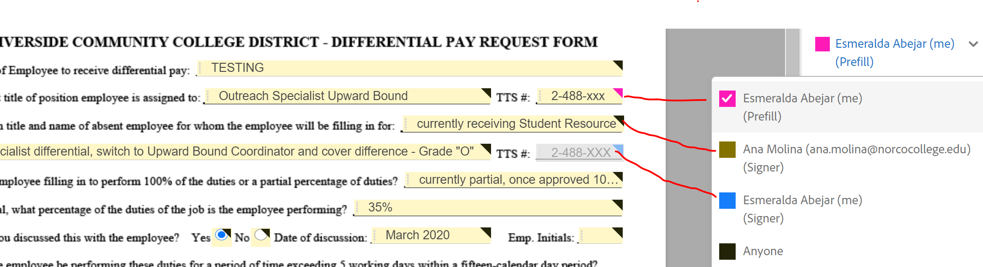
Assign fields
The color will help you identify what fields can be changed and who can change them.

Slide 11
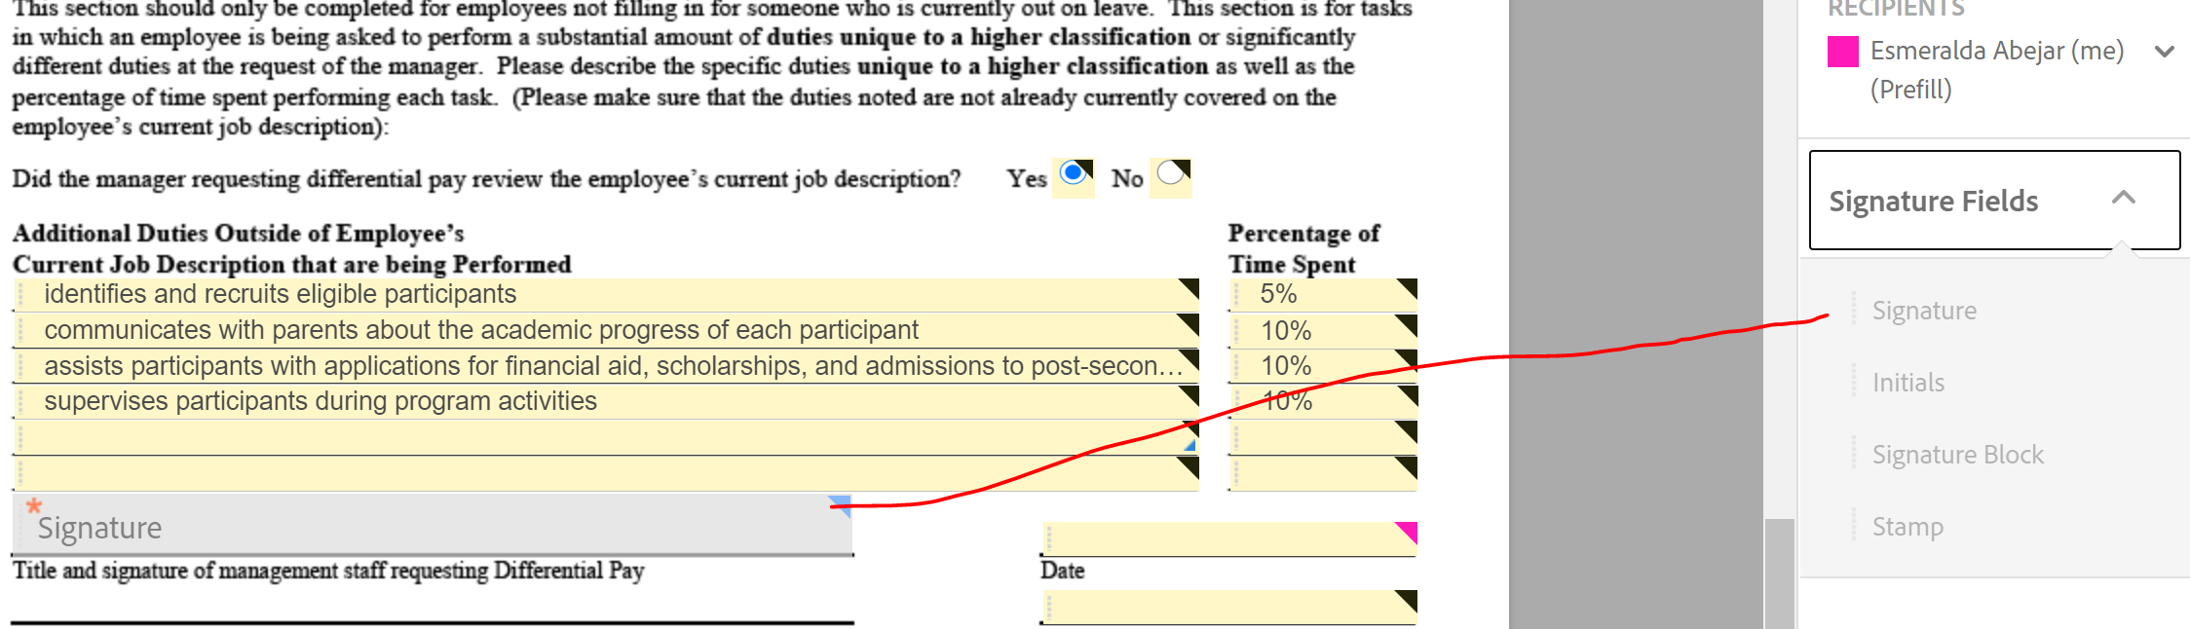
Add signature fields
Click and drag.
Your progress can be saved. Send when all the fields are filled out.

Slide 12
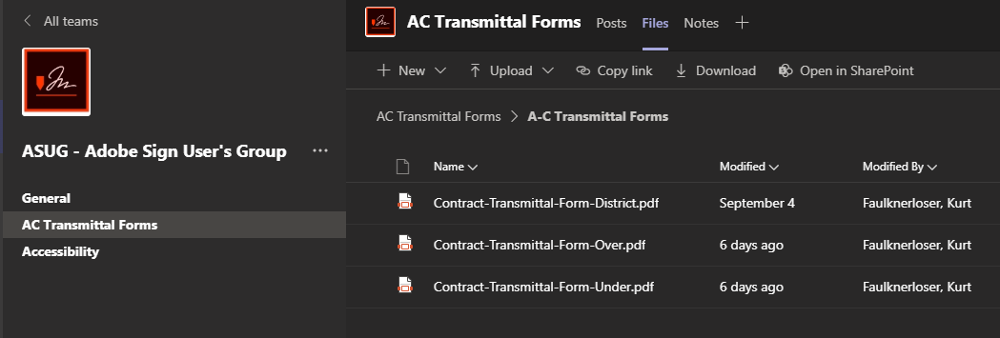
Who do I send the form to?
All forms and the order of signers are posted to a teams site.

Slide 13
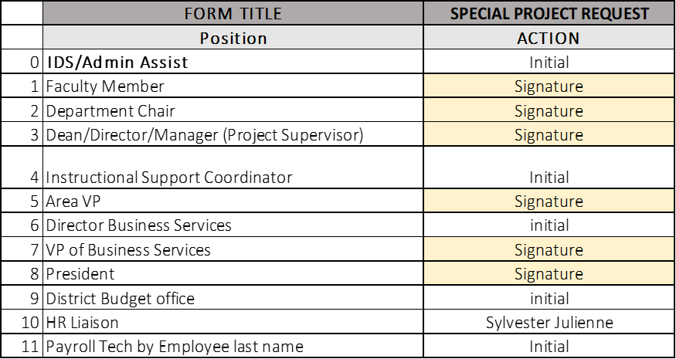
FACULTY FORMS APPROVAL FLOW

Slide 14
CLASSIFIED FORMS APPROVAL FLOW

Slide 15
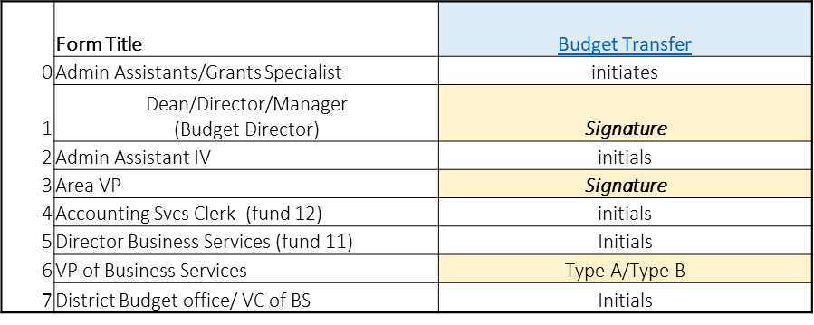
BUDGET APPROVALS

Slide 16
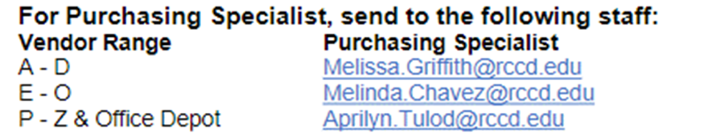
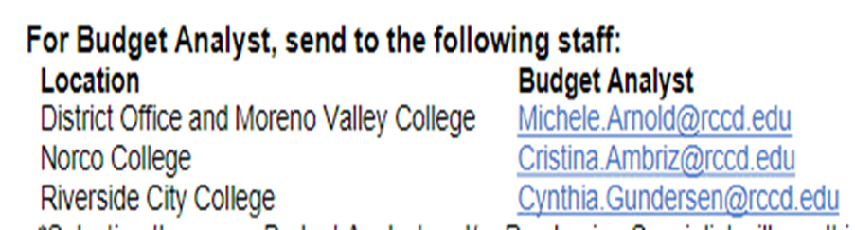
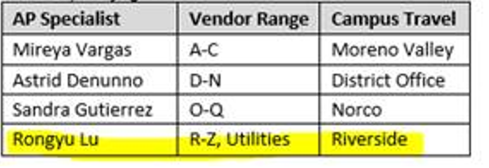
District contacts:

Slide 17
Recipients: approver, signer, delegator, acceptor
Sign in to Adobe.com/documents and click on Adobe Sign then click on Manage.
Review the document.
Check where the document is going next, all signers appear on the right hand side.
Sign the document.
You will receive an e-mail with the signed report and the audit form when the document has been fully signed.
DO NOT forward the e-mail, if you can’t sign the document, you can delegate to someone else.

Slide 18
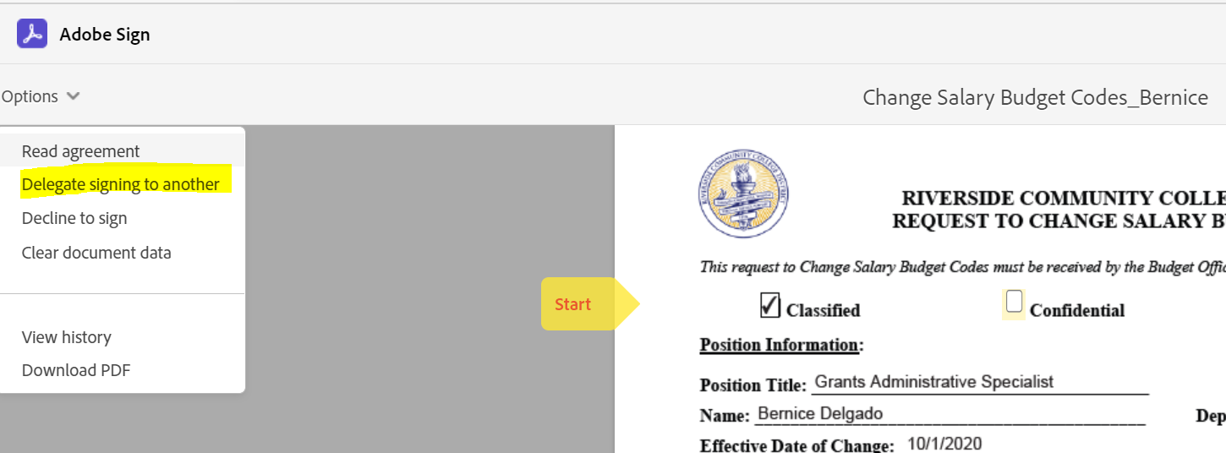
Delegate Signature
Signers who do not want to sign, DO NOT forward the e-mail from Adobe Sign instead delegate someone to sign on your behalf

Slide 19

a/C transmittal process

Slide 20
A/C transmittal form process
What is the Purpose of the A/C Transmittal Form
The purpose of the A/C Transmittal form is not to collect signatures.
Its purpose is to internally route an agreement or contract along with its supporting documentation to all parties involved with the approval of the agreement/contract.
This facilitates signing of the agreement/contract as well as other business processes involved with obtaining the goods and services described in the contract.

Slide 21
A/C transmittal form process
Do Not use Adobe sign to route A/C transmittal form for approval.
Do Not combine the contract with any transmittal documents, (requisition, contracts review approval, insurance, etc,.)
While it is encouraged to use Adobe Sign to secure digital signatures on the actual agreement/contract, it is important to understand that signing the agreement/contract is only part of the overall process that the A/C Transmittal Form supports.

Slide 22
A/C transmittal form process
What is the A/C Transmittal Form?
Is a fillable PDF form used to summarize the information contained in an agreement/contract
Consolidates additional required documentation
And provides instruction on where the agreement/contract should be routed for signature
There are three different A/C Transmittal Forms:
One for Colleges that can fully execute an agreement/contract ($95,200 and under)
One for Colleges that require Board approval and Signature from the Vice Chancellor of Business and Financial Services to fully execute the agreement/contract (over $95,200)
And one for all District agreement/contracts.
Please use the correct form according to the amount of the contract.
Each form outlines the approval process

Slide 23
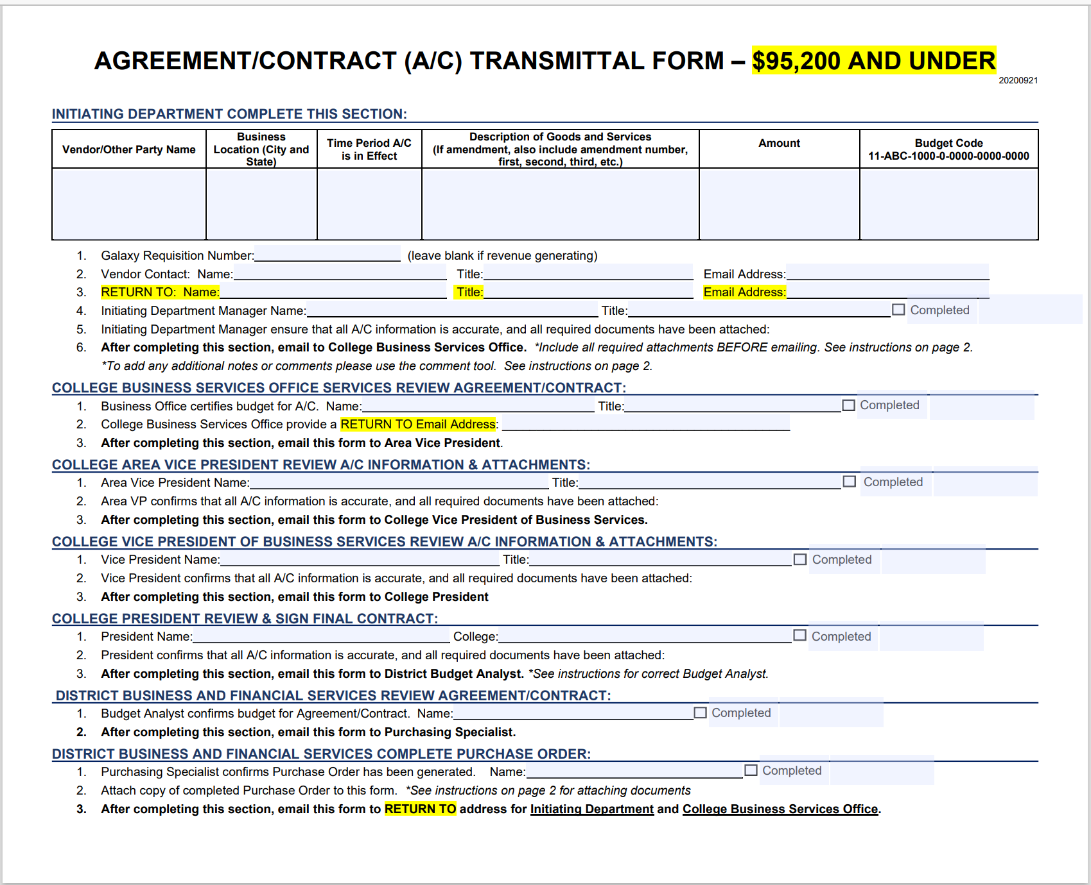
Where are the forms located?
TEAMS Group- ASUG-Adobe Sign user group
A/C comes to Business Service before Area VP

Slide 24
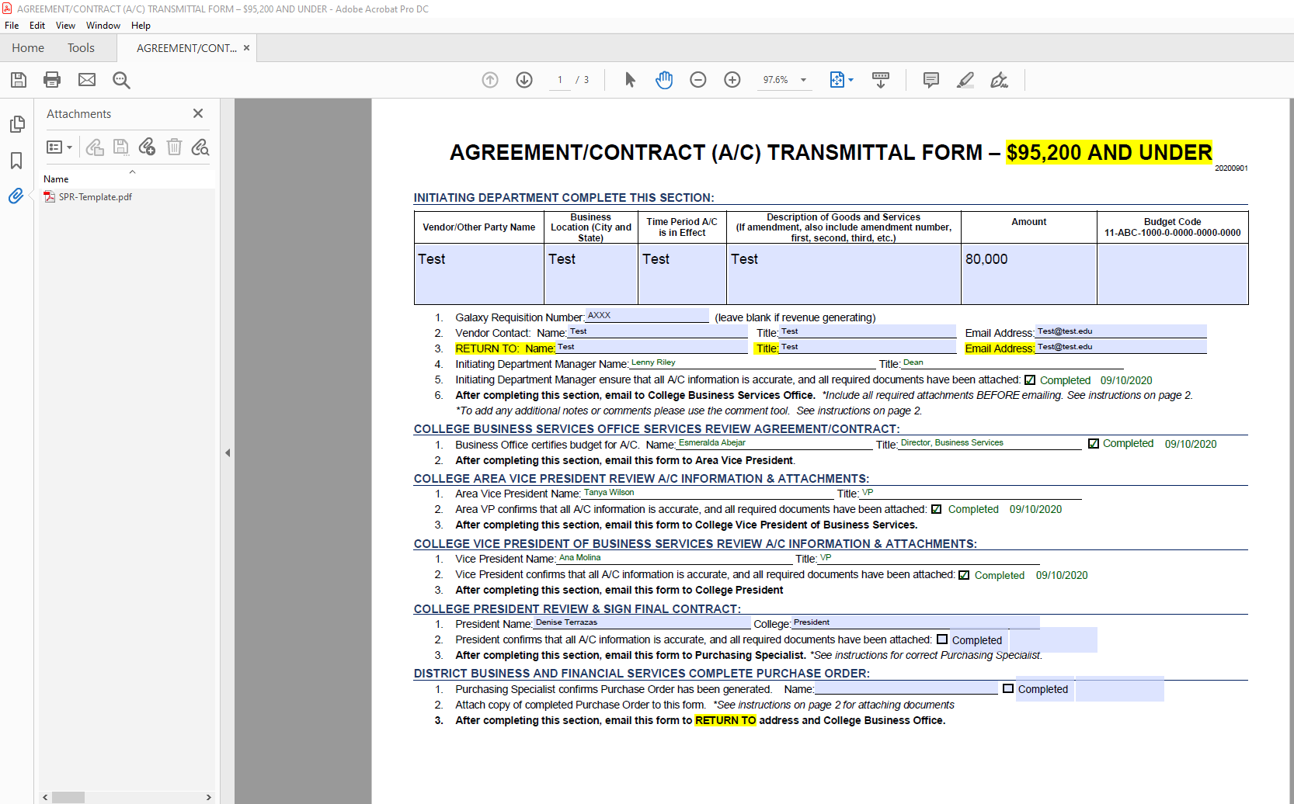
A/C TRANSMITTAL Form cont.,

Slide 25
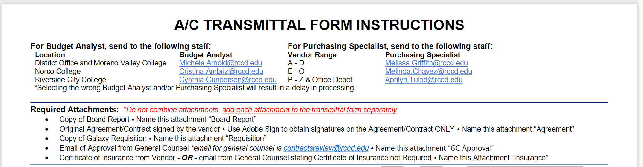

Slide 26
Cheat sheet for contract/agreement processing –
for department originator
Less than $95,200
More than $95,200
Ensure funding availability
Get agreement from vendor
Send agreement to contracts for review and clarification of insurance requirement
After approval, get signature from vendor and any required insurance. (If new vendor, obtain all new vendor forms required)
Enter a Type A requisition in galaxy. (Not needed for revenue contracts)
Complete A/C transmittal form (attach all required documents)
Send A/C transmittal form through the approval process via email.
When contract number is issued, department originator will contact vendor.
When job is completed and services rendered, send the invoice “approved for payment” to accounts payable.
Monitor your budget in galaxy to see payment is reflected in your account.
Ensure funding availability
Get agreement from vendor
Send agreement to contracts for review and clarification of insurance requirement
After approval, get signature from vendor and any required insurance
Prepare a board report and work with president’s office for submittal.
Enter a Type A requisition in galaxy. (Not needed for revenue contracts)
Complete A/C transmittal form (attach all required documents, including unapproved board report)
Send it through the approval process via email.
When contract number is issued, department originator will contact vendor.
When job is completed or services rendered, send an invoice approved for payment to accounts payable.
Monitor your budget in galaxy to see payment is reflected in your account.

Slide 27
CONTRACT TRANSMITTAL Approval PROCESS via e-mail
less than $95,200
More than $95,200
Route A/C transmittal form with required documents through the approval process via e-mail in this order:
Initiating department manager
College Business Services
Area VP
Business Services VP
College President
District Budget office
Purchasing
The President’s office will review A/C packet and sign the agreement.
The President’s office will send the A/C transmittal to District budget office for review, and signed agreement will be included.
District Budget office will send A/C form to Purchasing,
Purchasing will send the signed contract and signed purchase order back to the initiating department with a copy to College Business Services.
The initiating department will share purchase order and signed contract with the vendor and schedule any necessary work.
Route A/C transmittal form with required documents through the approval process via e-mail in this order:
Initiating department manager
College Business Services
Area VP
Business Services VP
College President
District Budget office
Purchasing
The President’s office will review A/C packet and sign agreement and add board report.
The President’s office will send A/C transmittal form to the District Budget office for review,
District Budget office will send A/C transmittal form to Purchasing for issuance of Purchase order,
Purchasing will confirm contract was board approved and obtain agreement signed by VC Business & Financial Services to issue contract purchase order.
Purchasing will send the signed contract and signed purchase order back to the department originator with a copy to Business Services
The initiating department will share purchase order and signed contract with vendor and schedule any necessary work.

Slide 28
During the approval process:
Manager approver will:
Save the A/C Transmittal form to your computer
Make sure you are using Adobe Acrobat (This is REQUIRED)
Open and review the documents attached.
If all documentation is correct, check the completed box in the A/C transmittal form next to your name. Hit save.
Go back to the e-mail received requesting your approval.
Reply to All and attach the A/C transmittal you just approved.
Add the next approver to your e-mail distribution

Slide 29
DEPARTMENT ORIGINATOR WILL:
Department originator to check Galaxy for issuance of contract purchase order.
Department originator will continue to follow up with Purchasing.
Make sure job is not initiated without a contract purchase order.

Slide 30
Questions? Thank you!!

