Slide 1
2025-2028 Student Equity Plan
Leveraging Student Voice to Address Systemic Equity Barriers

Slide 2
Student Equity Plan Overview & Components
The 2025-2028 Student Equity Plan template requires colleges to deploy the following strategies to close equity gaps:
Leverage student voice to advance institutional equity goals
Include strategies that are race-conscious
Develop an evaluation plan supporting continuous improvement
The SEP Template includes the following required components:
2022-2025 Plan Reflection
Executive Summary
Disproportionate Impacted Students by Metric
Intensive Focus
Student Education Plans
Vision 2030 Equity Alignment & Coordination
Due November 30, 2025

Slide 3
Student Equity & Achievement (SEA) Metrics
Successful Enrollment
Transfer Math & English
Persisted from Term to Term
Vision Goal Completion
Transferred to a 4-Year
Percentage of first-time in college students who applied and enrolled in the same year*
Percentage of first-time in college students who completed transfer-level math and English in first year*
Percentage of first-time in college students who enrolled in the subsequent semester*
Percentage of first-time in college students who completed a degree or certificate in three years*
Percentage of first-time in college students who transferred to a four-year institution in three years**
*first-time in college students who were credit enrolled and not special admit
**first-time in college students who were credit enrolled and not special admit who earned 12+ units any time in three years and exited CCC

Slide 4
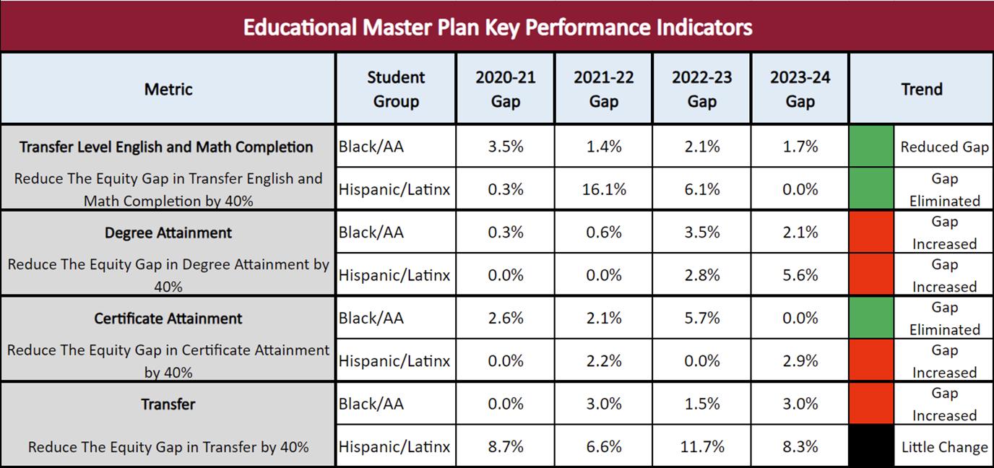
Student Equity Plan: KPI Progress

Slide 5
DI Populations by SEA Metrics
Primary Subgroup: Race/Ethnicity
Primary Subgroup | #1 Successful Enrollment (9) | #2 Compl Eng/Mat (11) | #3 Persist (10) | #4 Vision Compl (8) | #5 Transfer (7)
American Indian/Alaska Native | 2 | 5 | 1 | 3 | 3
Asian | 1 | 0 | 0 | 0 | 1
Black/AA | 7 | 3 | 4 | 0 | 0
Filipino | 0 | 0 | 0 | 0 | 0
Hispanic/Latinx | 0 | 6 | 1 | 2 | 6
Multiple Values Reported | 1 |  | 0 | 0
Pacific Islander or Hawaiian Native | 3 | 2 | 0 | 2 | 4
Two or More Races | 0 | 3 | 2 | 2 | 0
Unknown/Non-Respondent | 8 | 5 | 1 | 4 | 1
White | 5 | 0 | 0 | 0 | 0
*Limited years available due to new data element
Bold & Underline = DI in the most recent year
Highlighted = group with most years of DI

Slide 6
DI Populations by SEA Metrics
Primary Subgroup: Special Population
Primary Subgroup | #1 Successful Enrollment (9) | #2 Compl Eng/Mat (11) | #3 Persist (10) | #4 Vision Compl (8) | #5 Transfer (7)
Female | 3 | 1 | 1 | 0 | 0
Male | 0 | 2 | 2 | 5 | 3
Multiple Values Reported | 1
Non-Binary* | 0 | 3 | 0 | 1
Unknown/Non-Respondent | 6 | 0 | 0 | 2 | 0
First Generation | - | 9 | 6 | 3 | 5
DSPS | - | 2 | 0 | 0 | 1
Foster Youth | - | 4 | 2 | 4 | 0
Veteran | - | 2 | 0 | 0 | 0
LGBT* | - | 2 | 3 | 3 | 0
Perkins | - | 1 | 0 | 0 | 2
*Limited years available due to new data element
Bold & Underline = DI in the most recent year
Highlighted = group with most years of DI

Slide 7
2025-2028 New DI Populations
Group | Metric (recent year only) | Cohort (denominator) | Current Count (numerator) | Number to Close Gap
Non-Binary | Vision Completion | 4 | 0 | 1
LGBTQ | Vision Completion | 193 | 14 | 10
LGBTQ | Persistence | 113 | 58 | 14
Amer Indian/ Alaska Native | Transfer Eng/ Math | 5 | 0 | 1
Amer Indian/ Alaska Native | Vision Completion | 7 | 0 | 1
Amer Indian/ Alaska Native | Transfer | 2 | 0 | 1
Unknown Ethnicity | Successful Enrollment | 204 | 14 | 26
Unknown Ethnicity | Transfer Eng/ Math | 82 | 5 | 8
Unknown Ethnicity | Vision Completion | 90 | 2 | 10
Hispanic/Latino | *1st Yr Comp SEP (Spring 24) | 250 | 59 | 15
*New data element in 2025-2028 SEP

Slide 8
SEP DI Intensive Focus
Primary groups showing disproportionate impact the greatest number of years
Group | Metric Number | Metric Description | Students to fully close gap (most recent year available)
Black/African American Students 6% of FTCS 4% of First Gen students | 1 | Successful Enrollment | 28/405
 | 3 | Persistence | 9/95
Hispanic/Latinx Students 62% of FTCS 72% of First Gen Students | 2 | Compl Transfer Eng/Mat | 86/1073
 | 4 | Vision Completion | 18/1519
 | 5 | Transfer | 47/523
No longer the most DI group longitudinally
Notes:
NEW: all conclusions hold up EXCEPT Hispanic Vision completion
Limited to first time college students F24:
72% of first gen students are Hispanic
4% of first gen students are Black
First gen = parent(s) are HS grad or lower
ORIGINAL: Groups experiencing the most DI for the years included. Talk about the intersectionality of first gen and gender within the 2 larger student groups identified. Benefits of focusing efforts instead of diffusing resources.

Slide 9

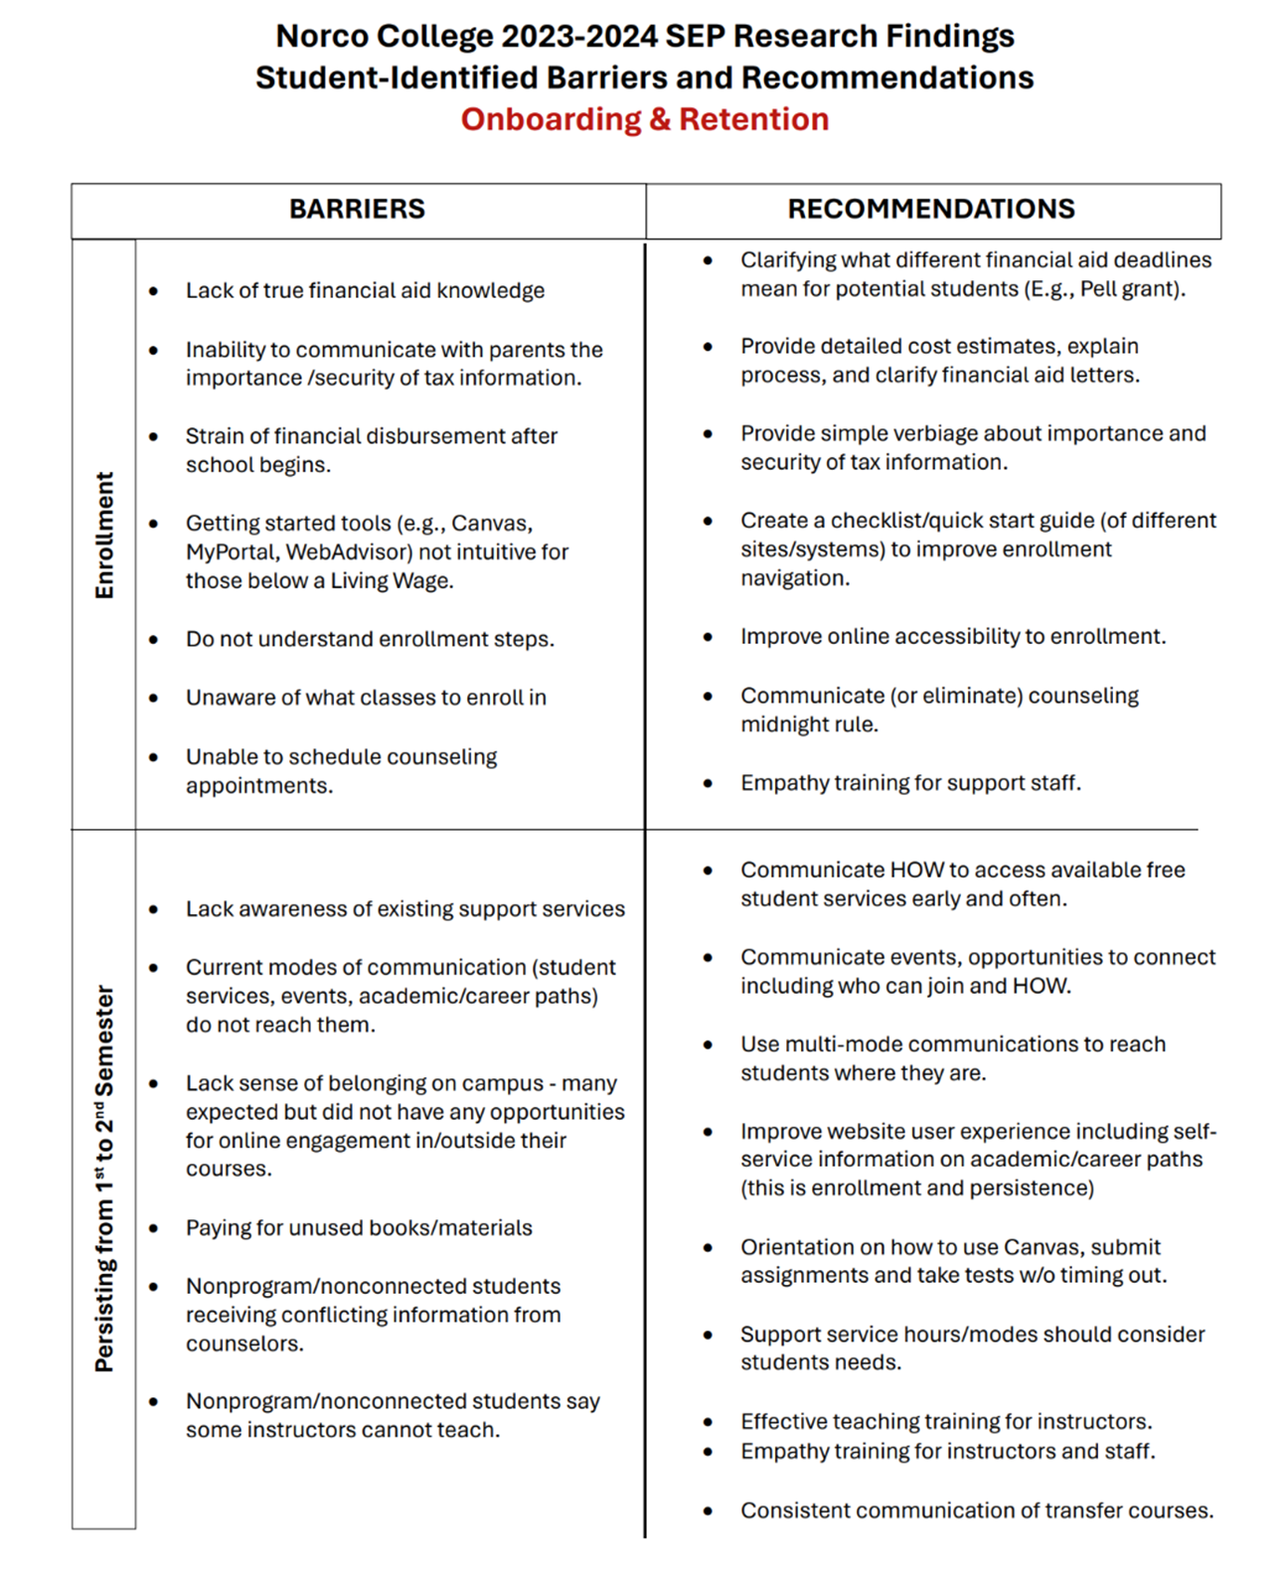
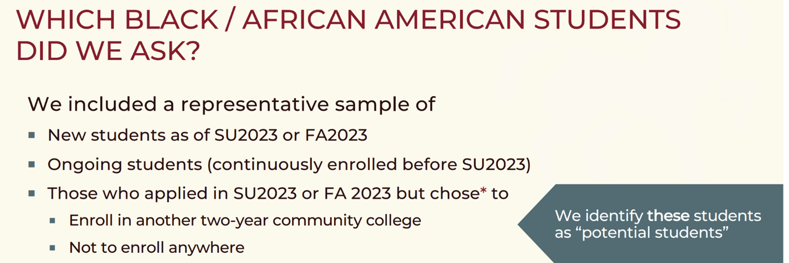
Black Student Outcomes
“I woke up feeling tired and having some pain. I felt like I had a productive day, but I was tired physically and emotionally” – Potential Student
“I also wish I knew how accessible tutors were, I didn’t know it was free and actually thought you had to pay” – Ongoing Student
“I just would like to have a clear pathway to the AS degrees available, which has been difficult finding online” – New Student
Notes:
T. James

Slide 10

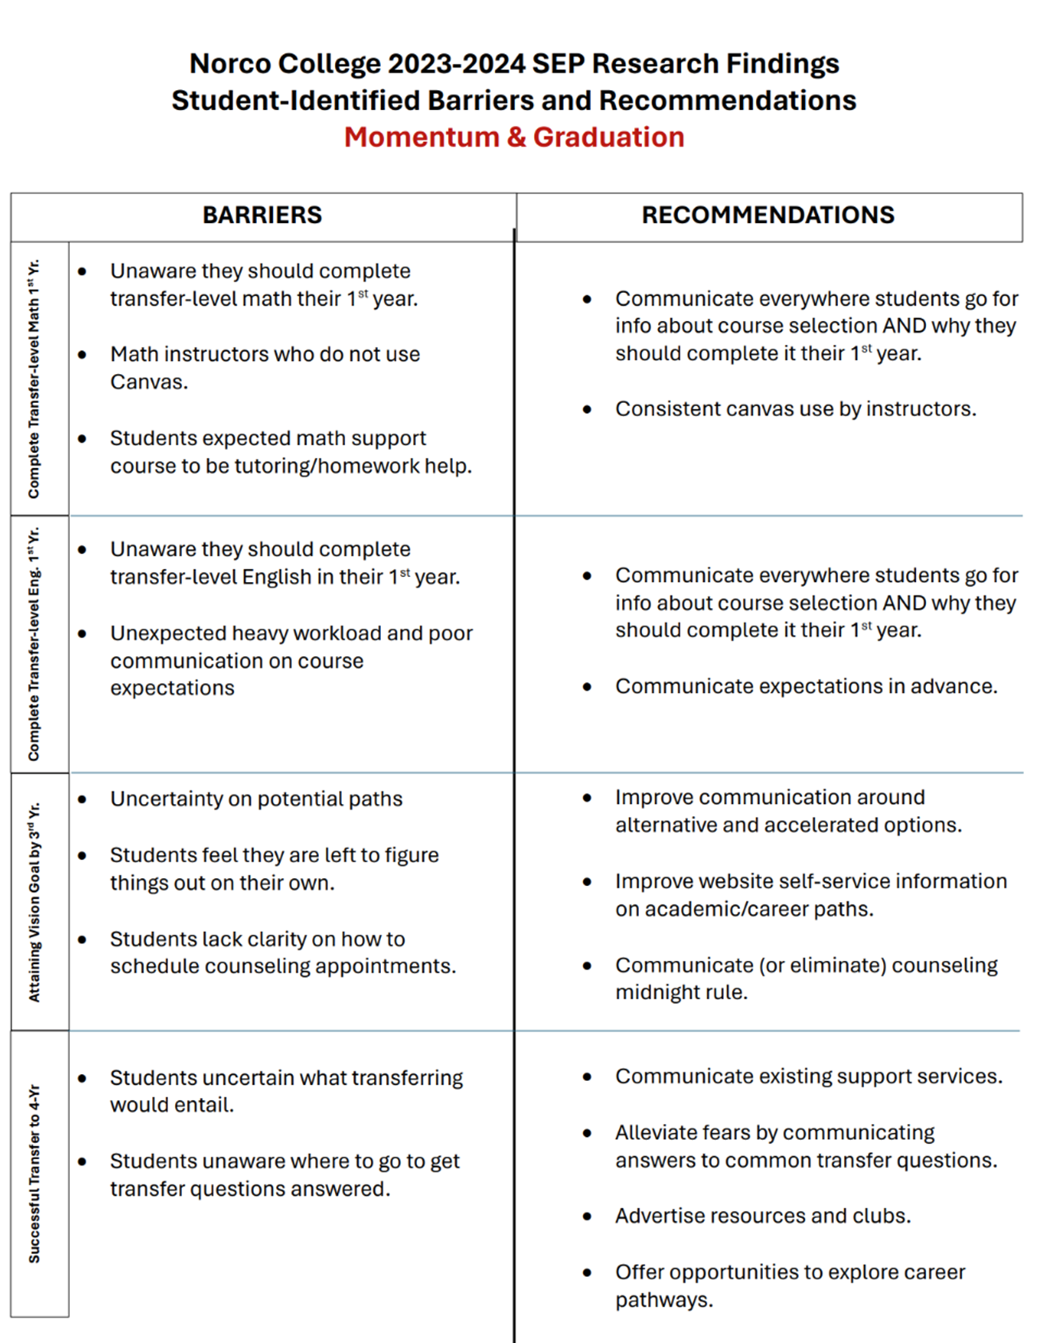
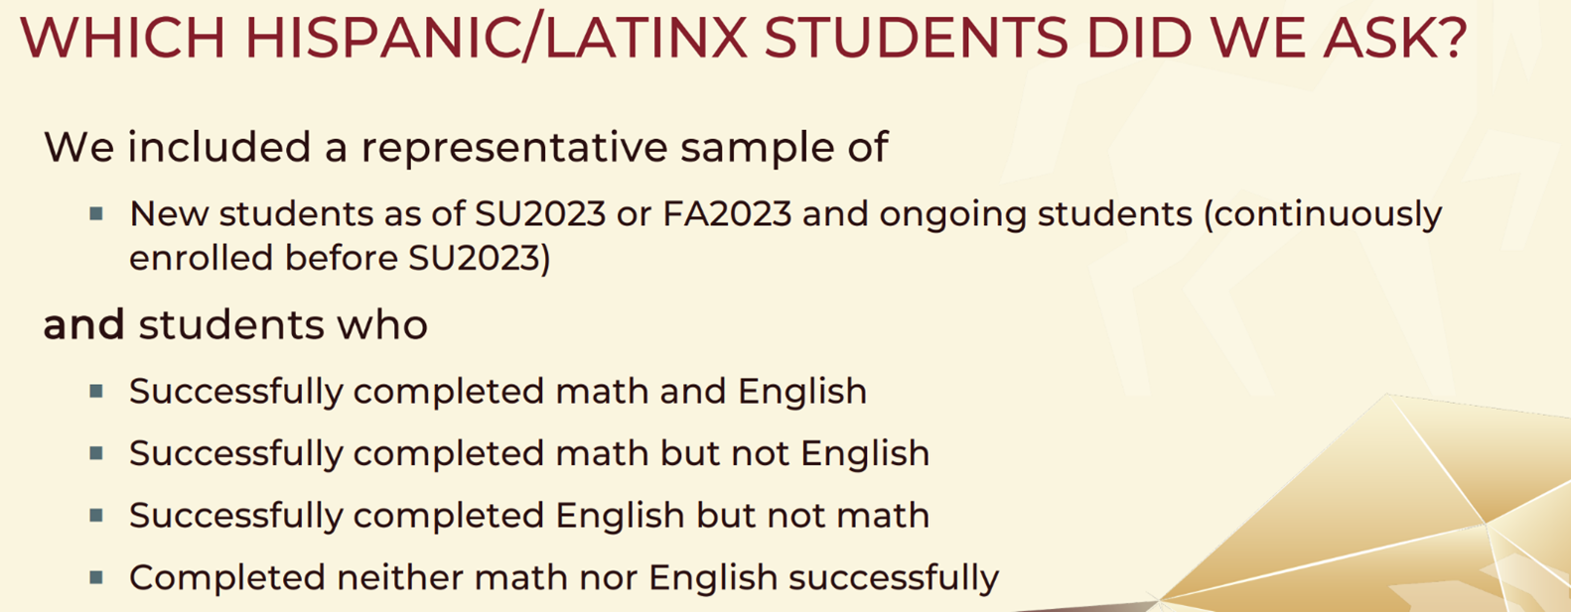
Latinx Student Outcomes
“The load needs to be a normal amount because students have lives, families, job stress and other classess. To me it was a very stressful class and I would not retake it if I could” – Ongoing Student on English Course
“I don't know anything about trying to get into a four-year college, and also, I understand attending a four-year college has a much higher tuition rate” – Ongoing Student on Transfer
Notes:
T. James

Slide 11
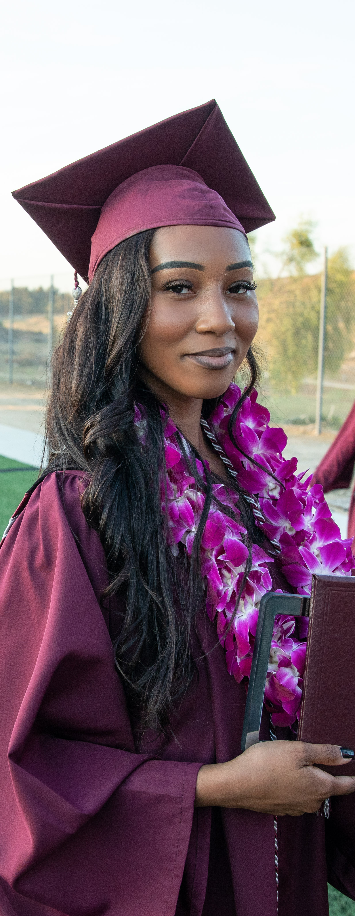
2025-2028
Action Plan
Strategic Planning
College Reorganization to align equity programs under Planning & Development
Professional Development
LFM Team: Faculty Impact Study
Communication
Website, with a focus on self-service
Faculty Teaching Institute
Proposal for Caring Campus
Alignment of strategic goals and equity metrics
Annual DEIA Summit
Enrollment Management: A&R Collaboration with Academic Affairs
Equity Summer Bridge and FYE with Title V Grant
Joint Student Support Operational Group of SS and PD
#CCHALES Research Collective l #EquityStartsToday
Notes:
T. James

Slide 12
Timeline
First Readings:
Thursday, April 24, 2025 – All Leadership Councils
Monday, May 5, 2025 – Academic Senate
Thursday, May 8, 2025 – College Council
All-Governance Votes:
Monday, May 12, 2025 – Academic Senate
Thursday, May 22, 2025 – All Leadership Councils
Thursday, September 4, 2025 – College Council
District-Level Approval:
Friday, September 19, 2025 - District Strategic Planning Council
Monday, October 13, 2025 - Chancellor’s Cabinet
Monday, November 3, 2025 - Board of Trustees
November 30, 2025 - Submission

Slide 13
Q & A

Slide 14
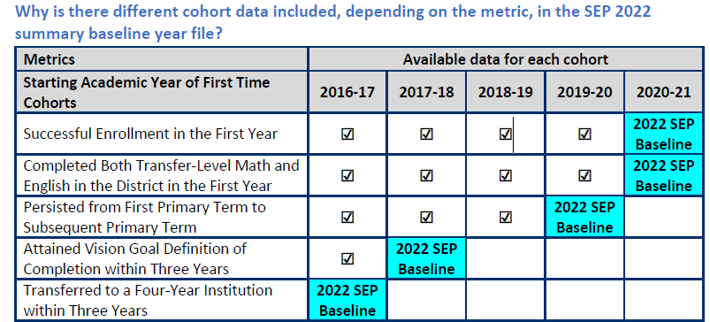
New Data
Cohort Based
Available cohort years for each metric:
Notes:
Data is now cohort based- new students at our college. The most recent year available is different based on the metric
#1= applied and enrolled beyond census at the same college (Only available for Ethnicity and Gender because it relies on CCCApply data)
#2= proportion who completed both transfer-level math and English in their first academic year of credit enrollment within the district
#3= persisted from their first primary term of enrollment to the subsequent primary term
#4= the number of students who earned one or more of the following: Chancellor’s Office approved certificate, associate degree, and/or CCC baccalaureate degree
#5= earned 12 or more units at any time and at any college up to and including the selected year and who exited the community college system, the number of students who enrolled in any four-year postsecondary institution in the subsequent year

Slide 15
Primary DI and Intersectionality
Primary DI
Compares the primary group to all other students
PN
Primary group is not disproportionately impacted, look deeper to see if there is DI when comparing gendered subgroups to all other students
PY
Primary group is identified as disproportionately impacted, look deeper to see if there is DI within gender
Notes:
Primary- compares one ethnic group to all other students. Ex- Hispanic students compared to all others
Talk about PN scenario when you look deeper to see if there is DI for the gendered subgroups
Talk about the PY scenario when there is also intersectional Di within gender

Slide 16
Headcount for Primary Groups
Ethnicity | Count | Percent
American Indian/Alaska Native | 7 | 0.3%
Asian | 195 | 7.5%
Black or African American | 138 | 5.3%
Filipino | 48 | 1.8%
Hispanic | 1,450 | 55.7%
Pacific Islander or Hawaiian Native | 13 | 0.5%
White | 574 | 22.0%
Two or More Races | 41 | 1.6%
Unknown/Non-Respondent | 138 | 5.3%
Overall | 2,604 | 100%
Ethnicity | Count | Percent
Female | 1,242 | 47.7%
Male | 1,322 | 50.8%
Non-Binary | 4 | 0.2%
Unknown/Non-Respondent | 36 | 1.4%
Overall | 2,604 | 100%
Notes:
Headcounts to help frame the magnitude of DI

Slide 17
Headcount for Primary Groups
Primary Groups | Count | Proportion of Population
First Generation | 866 | 33.3%
DSPS | 194 | 7.5%
Foster Youth | 76 | 2.9%
Veteran | 133 | 5.1%
LGBT | 82 | 3.1%
Perkins | 1,723 | 66.2%
Notes:
Perkins students make up 2/3 of the population and first gen is 1/3

Slide 18
Summary Matrix (Count of years with DI)
 | #1 Successful Enrollment (7) | #2 Completion English/Math (10) | #3 Persist (9) | #4 Vision Completion (7) | #5 Transfer (6)
American Indian/Alaska Native | 2 | 3 | 1 | 0 | 2
Asian | 0 | 0 | 0 | 0 | 0
Black or African American | 7 | 3 | 6 | 1 | 0
Filipino | 1 | 0 | 0 | 1 | 0
Hispanic | 0 | 5 | 0 | 3 | 6
Multiple Values Reported | 0 | 0 | 0 | 0 | 2
Pacific Islander or Hawaiian Native | 2 | 2 | 0 | 2 | 4
Two or More Races | 0 | 2 | 1 | 2 | 0
Unknown/Non-Respondent | 3 | 3 | 2 | 2 | 1
White | 1 | 0 | 1 | 0 | 0
Bold & Underline = DI in the most recent year
Highlighted = group with most years of DI
Notes:
Primary ethnicity- Black students looks like they are struggling with the first-year outcomes and Hispanic students are struggling with completion outcomes

Slide 19
Summary Matrix (Count of years with DI)
 | #1 Successful Enrollment (7) | #2 Completion English/Math (10) | #3 Persist (9) | #4 Vision Completion (7) | #5 Transfer (6)
Female | 4 | 1 | 1 | 0 | 0
Male | 1 | 2 | 3 | 3 | 3
Multiple Values Reported | 0
Non-Binary | 0 | 2 | 0
Unknown/Non-Respondent | 0 | 0 | 0 | 0 | 1
First Generation | - | 7 | 6 | 2 | 5
DSPS | - | 1 | 0 | 0 | 2
Foster Youth | - | 3 | 1 | 3 | 2
Veteran | - | 2 | 0 | 0 | 0
LGBT* | - | 2 | 1 | 1 | 1
Perkins | - | 1 | 0 | 0 | 4
*Limited years available due to new data element
Bold & Underline = DI in the most recent year
Highlighted = group with most years of DI
Notes:
Primary groups- first gen is 1/3 of our population

Slide 20
Takeaways
Primary groups identified as DI in the greatest number of years
Group | Metric | Metric Description | Students to close gap (most recent DI year)
Black/African American Students 5% of FTCS 3% of First Gen students | 1 | Successful Enrollment | 30
 | 3 | Persistence | 17
Hispanic Students 60% of FTCS 75% of First Gen Students | 2 | Completion Transfer Eng./Mat | 36
 | 4 | Vision Completion | 53
 | 5 | Transfer | 93
Notes:
Groups experiencing the most DI for the years included
35% of Hispanic Students are first gen
20% of Black Students are first gen
423 first gen FTCS (423/1357 = 31%)
Asian 27 6.4%
Black or African American 12 2.8%
Hispanic/Latino 317 74.9%
American Indian or Alaska Native 1 0.2%
Native Hawaiian or other pac islander 2 0.5%
Two or More Races 10 2.4%
White 52 12.3%
Unknown 2 0.5%

Slide 21
Student Equity Plan Tools

Slide 22
Components for each subgroup per metric chosen
01
Target Goals
Structural Evaluation
02
One-, two-, three-year goals set for the subgroup and metric
Evaluate existing and identify ideal processes, policies, practices, and culture
Planning & Action
Support Needed
03
04
Describe plan to move from current to ideal (goal) for the subgroup and metric
Describe support needed to advance goals
Notes:
Reminder – for each group you choose, you have to complete each section again

Slide 23
Target Goals
What outcomes will your college set for this metric and population for 2022-25?
Qualitative
Numeric
Conceptual/
Relative
Increase Black students’ sense of belonging
(survey data)
Increase completion rates of Latinx students by 5%
Eliminate gender equity gaps for Filipino men

