Slide 1
Student Success Teams
Norco College
Summer 2018

Slide 2




Supporting Students within Our Four Schools

Slide 3
Student Success Team Members
Onboarding
*Case Management
School Ed Advisor
SEP Development
Ongoing Counseling
Student Outreach Support
Special Program Case Management
Counselors
SS Coach/ Ed Advisor
School Ambassadors
Faculty Leads
Program Advising
Faculty Advisors
*Counselor-directed case management performed by educational advisor or success coach, if student in a special program
School Communication Liaison

Slide 4
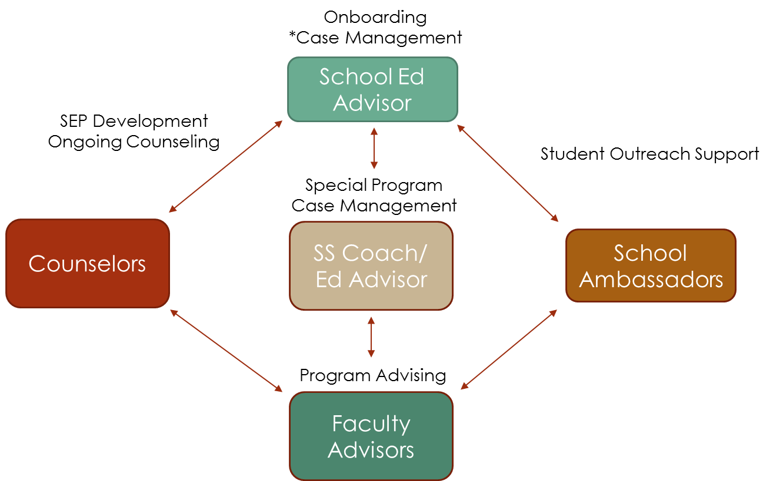

Counselor Role
Counselors
ROLE
Holistic counseling
Develop comprehensive Student Education Plan (SEP)
Monitor SEP progress
Identify academic & non-academic milestones
Proactive outreach to students who veer off path
Guide educational advisors/success coaches in case management activities
COLLABORATION
Ed Advisors/Success Coaches - support timely interventions
Faculty Advisors – support student development in program area
Build School community on campus to support completion

Slide 5


School Educational
Advisor Role
ROLE
Support new students in Onboarding
Support early career assessment
Discuss initial college/career goals
Explain School trailhead/1-semester plan
Connect 1-on-1 with students off path
Guide students on tracking their progress
Initial connection with EduNav
Orient students to college resources
Provide direction to School Ambassadors
COLLABORATION
Counselors – Case management development and timely intervention
Career Center – Explore paths for undecided students
Transfer Center – Promote transfer process, workshops, and fairs
Faculty Advisors – Refer students to faculty office hours
Special Programs – Refer students to special programs when appropriate

Slide 6
Student Success Coach/
Educational Advisor Role
Special Program
SS Coach/ Ed Advisor
ROLE
Proactive case management
Orient students to special program
Acclimate student to college and resources
Build rapport through active listening
Support students towards educational goal
COLLABORATION
Counselors – Case management development and timely intervention
Career Center – Explore paths for undecided students
Transfer Center – Promote transfer process, workshops, and fairs
Faculty Advisors – Refer students to faculty office hours

Slide 7
School Ambassador Role
School Ambassadors
ROLE
Create School awareness for enrolled students
Cultivate student feedback and act as a touch point for the School
Promote and attend School activities
School tabling
Promote School pathways
Connect students with college and School resources
COLLABORATION
Educational Advisors – Receive direction and support for role
Faculty Advisors – Refer students to faculty office hours

Slide 8

Faculty Advisors
Faculty Advisors
ROLE
Providing information regarding programs, career opportunities, and course selection in their disciplines
Referring students to appropriate services: the faculty advisor can provide a link for the student with other essential services: counseling, financial aid, career center, veteran’s resource center, services for students with disabilities, tutoring center, health center, etc.
COLLABORATION
Counselors – Refer when students more than discipline-specific information
Educational Advisors/Success Coaches – Refer for student support to stay on path
School Ambassadors – Identify outreach opportunities

Slide 9

Faculty Leads
Faculty Leads
ROLE
Communication liaison with department chairs, discipline leads, faculty advisors
Distribute School student information
Provide School coverage at college events (e.g. Welcome Day, Summer Advantage, Club Rush)
Assist with coverage and communication dissemination of School-related activities
COLLABORATION
Dean of Instruction
Department Chairs
Discipline Leads
Faculty Advisors

Slide 10
Student Success Team Flowchart
Onboarding
*Case Management
School Ed Advisor
SEP Development
Ongoing Counseling
Student Outreach Support
Special Program Case Management
Counselors
SS Coach/ Ed Advisor
School Ambassadors
Faculty Leads
Program Advising
Faculty Advisors
*Counselor-directed case management performed by educational advisor or success coach, if student in a special program
School Communication Liaison

Slide 11
Implementation Timeline
July 1, 2018
Onboarding – F2F OAC+Career
Case Management by School
Fall 2018
Employ Student Success Team Model
EduNav for selected new ADT students
Winter 2019
Employ new changes to Student Success Team
Spring 2019
Evaluate/Modify Student Success Team
Winter Student Success Team Retreat/Spring Plan Development
Adopt Salesforce for case management
Explore Salesforce for case management
Expand EduNav to all new students

Slide 12
2018-2019 Student Success Teams by School
Marshall Fulbright
Dean of Instruction
Alex Spencer
Educational Advisor
Student Success Coaches by Program
Jessica Dobson Faculty Lead
Kim Kamerin Faculty Lead
School Ambassadors TBD
John Moore Counselor
Jethro Midgett Counselor
Nick Franco
Counselor
Faculty Advisors
By School

Slide 13
2018-2019 Student Success Teams by School
Marshall Fulbright
Dean of Instruction
Alex Spencer
Educational Advisor
Student Success Coaches by Program
Maria Jurado
Counselor
Lisa Martin
Counselor
Courtney Buchanan Faculty Lead
Sarah Burnett
Faculty Lead
School Ambassadors TBD
Faculty Advisors
By School

Slide 14
2018-2019 Student Success Teams by School
Jason Parks
Dean of Instruction
Nelya Parada
Educational Advisor
Student Success Coaches by Program
David Payan Counselor
Marissa Illiscupidez Counselor
Patty Worsham Faculty Lead
Rex Beck
Faculty Lead
School Ambassadors TBD
Faculty Advisors
By School

Slide 15
2018-2019 Student Success Teams by School
Jason Parks
Dean of Instruction
Nelya Parada
Educational Advisor
Student Success Coaches by Program
Erin Spurbeck Counselor
Sean Davis
Counselor
Jeff Warsinski Faculty Lead (Tech, Engineering, & Math)
Stan Tyler
Faculty Lead (Health & Science)
School Ambassadors TBD
Christine Ediss-Lopez
Counselor
Faculty Advisors
By School

Slide 16

*Student Success Coaches/Educational Advisors by Special Program
Steven Gonzalez
Ed Advisor EOPS/CARE
Daniel Landin
Ed Advisor
JKF
Justin Mendez
SS Coach
FYE
Anita Bailey
SS Coach Umoja
Ruth Jones
SS Coach
Foster Youth
Dallas Carter
SS Coach
SSS/RISE
Vacant
Ed Advisor Summer Advantage
Rosalina
Hernandez
Ed Advisor
AEBG
*Positions support students in all Schools

