Slide 1
Onboarding Re-engineered
Norco College
2018-2019

Slide 2
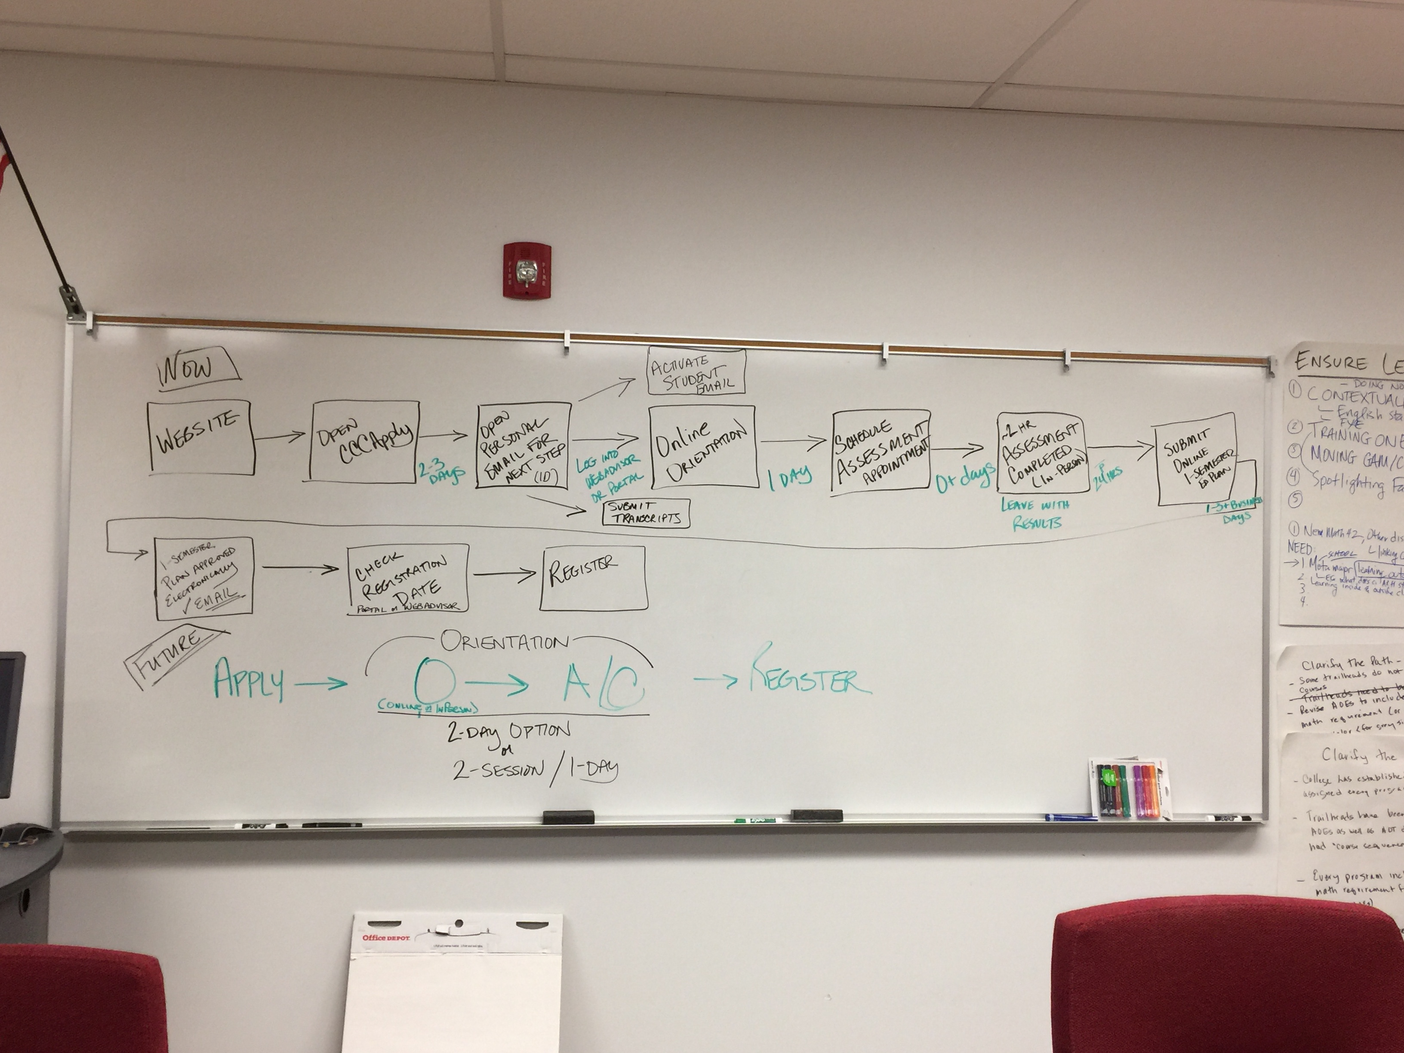
Onboarding Exercise – Spring 2018

Slide 3
Spring 2018 Student Interview – Q#1: When you applied to college did you receive any help from out the college staff and resources?
Michelle
Gabriel
Yes, my high school counselor
Yes, my mom

Slide 4
Spring 2018 Student Interview – Q#2: Did you apply with a goal or major in mind?
Michelle
Gabriel
Video game design
No, but the process of figuring it out is getting easier

Slide 5
Spring 2018 Student Interview – Q#3: When you applied to Norco College, do you remember the steps involved to become a student and to register for classes? How many steps were involved?
Michelle
Gabriel
Avid teacher helps me apply online; got email to schedule assessment appointment; online orientation; took assessment; talked to an ed advisor so I knew what classes to take
“I think 6 steps”
Went to DRC Counselor; scheduled assessment appointment; waited for email; followed up on steps in email
Assessment test was a hassle; asked me about family so I had to come back and finish it later
My sister told me to go meet with a counselor so I would know what classes to take
“There were most likely 6-7 steps

Slide 6
Spring 2018 Student Interview – Q#4: What stood out to you as useful during the process of applying for college and enrolling in classes?
Michelle
Gabriel
Online orientation and assessment
I underestimated the community college – it’s a “big deal”
In high school everything handed to us – in college I have to figure it out on my own
I would not be here without counselors
“Had bad experience with financial aid”…had to visit many times until finding the right person to assist – sweetest lady ever. It was a lot of work but I finally got a FA in November
Counselor guided me step-by-step
“Honestly thought I would not succeed because of my disability”
In speaking of DRC Counselor, “she helped out every step of the way, even with email they respond back very quick” … so different from high school and my family

Slide 7
Onboarding Pre-2018/2019
Apply to College
1. Visit website
Welcome Email
1. In 2-3 days, email with next steps received (different for some student groups)
2. Receive student ID
3. Activate student email
4. Submit transcripts
5. Apply for financial aid
6. Login to WebAdvisor or Student Portal
Online Orientation
1. In Student Portal, click the link to the online orientation
2. Complete 40+ minute online orientation that includes test questions (Comevo)
3. Receive certificate of completion
4. Wait 1 day to schedule Assessment appointment
2. Click on “Apply Now”
3. Taken to Open CCC Apply link
4. 10 minutes to set up account
5. ~30 minutes to complete application
6. Open CCC Apply confirmation email received
DAY 1
Day 3-4
Day 3-4

Slide 8
Onboarding Pre-2018/2019 continued…
Schedule Assessment
1. Login to Portal
2. Schedule Assessment Test – may take same day or up to 2 weeks out
3. Practice sample tests
Assessment Testing
1. Visit Assessment Center located in the Learning Resource Center in the Library (not easy to find)
2. Check-in
3. Answer multiple measure questions
4. 2-3 hours testing
5. Obtain assessment results
6. Wait 24 hours before continuing to next step
One-Semester Ed Plan
1. Login to Portal
2. Follow 1-semester ed plan directions
3. Submit 1-semester ed plan via email
4. 1-3 business days receive response from ed advisor with approved 1-semester ed plan
5. Wait for registration date
6. Check Portal for registration date
DAY 5
Day 6 (or more)
Day 7-8

Slide 9
New Onboarding in 2018/2019
Apply to College
1. Visit website
Welcome Email
1. In 2-3 days, email with next steps received (different for some student groups)
2. Receive student ID
3. Activate student email
4. Submit transcripts
5. Apply for financial aid
6. Login to WebAdvisor or Student Portal
Orientation
Orientation includes:
2. Click on “Apply Now”
3. Taken to Open CCC Apply link
4. 10 minutes to set up account
5. ~30 minutes to complete application
6. Open CCC Apply confirmation email received
1. Online or F2F orientation session
2. Assessment testing (Math Accuplacer, English/Reading MMAP)
3. Career Exploration – True Colors
4. Meet with ed advisor –
a. Career Exploration
b. Intro to School
c. Trailhead (abb. SEP)
d. Connect with college resources
e. Schedule counseling appointment
f. Next steps
DAY 1
Day 3-4
Day 3-4

Slide 10
