Slide 1

Committee of the Whole
2019-20 Adopted Budget and BAM Update
November 7, 2019
TOPICS:
Adopted Budget Update
Budget Allocation Model (BAM) Update
Presented by: Dr. Michael T. Collins, VP Business Services

Slide 2


FY 18/19 and 19/20 Budget by Category
83.3% 19/20 Budget - Salaries and Benefits
16.7% of 19/20 Budget Non-Salary

Slide 3
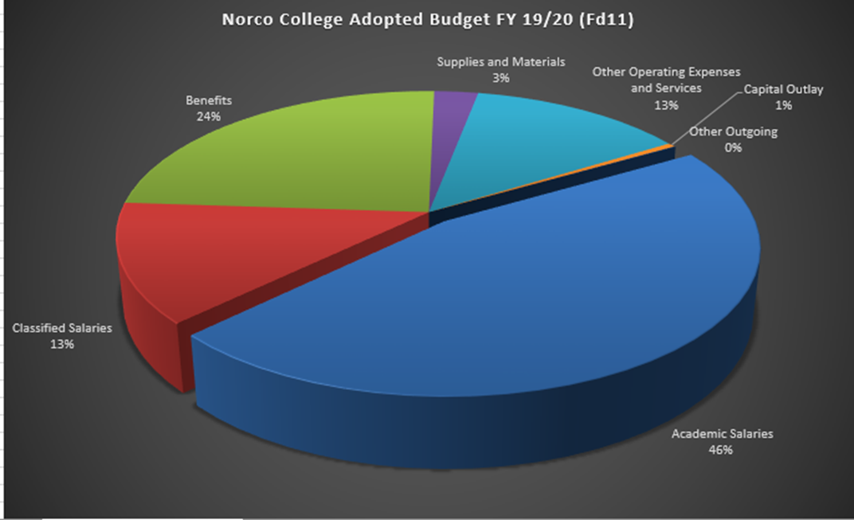
General Fund 19/20 Budget by Category

Slide 4
District Budget Allocation Model Update
Fair – Resource allocation decisions will be informed by objective, predictable, verifiable, and easily accessible data and will be made in an impartial and consistent manner.
Equitable – Resources will be distributed in a manner that adequately supports the full array of programs offered at each college while ensuring compliance with statutory and regulatory requirements; efficient and strategic use of resources is expected, and inefficiencies will not be subsidized or supported.
Transparent – Resource allocation decisions will be made in an open and consultative manner with representative stakeholder groups and that it is simple, easy to administer and communicate as possible.

Slide 5
2020-21 BAM CONCEPT
The District is primarily funded through apportionment, based on the number of Full-time Equivalent Students (FTES) we serve annually, even under the new Student Centered Funding Formula (SCFF) = 70% of the apportionment calculation.
The BAM will use the FTES discipline “Exchange Rates” to allocate funding to the colleges.
Revised BAM will be implemented in the 2020-21 fiscal year.
2019-20 fiscal year is a “hold harmless” year, expense budgets are not impacted.

Slide 6
Procedural Steps in 2018-19
To determine the “Exchange Rate” per FTES, the project team gathered multi-year historical General Fund “Discipline Cost per FTES” information for each college
The “Discipline Cost per FTES” includes the following:
Direct Cost of Instruction (Faculty, Lab Technicians, Classified Positions, etc.)
- Non-Instructional Costs (Deans, Administrative Staff, etc.)
Shared costs (administration/support – Business Services, Student Services and Other)
Allocated on the same basis as Non-Instructional costs/FTES

Slide 7
Procedural Steps in 2018-19 (cont.)
Disciplines were grouped into the following categories to derive consistency and comparability among the college:
STEM
Liberal Arts
Career and Technical Education (CTE)
“Unique” (Defined as a discipline only offered at one college)

Slide 8
2018-19 Adopted Budget Funding Rate Per FTES by College
Riverside City College- $3,171 per FTES
Moreno Valley College- $3,119 per FTES
Norco College- $2,613 per FTES

Slide 10
“TO DO” Tasks in 2019-20
1. Analyze and justify “Unique” disciplines
2. Develop a treatment for “District Operations” costs
3. Establish the “Exchange Rate” (mean or median) for discipline categories
4. Model revenue flow through the revised BAM- determine true funding
impacts to the college
5. Analyze/implement budget development improvements that allow for
planning
6. Analyze strategic programs/considerations that impact the cost of an FTES
7. Further consider the “Comprehensive College” allocation
8. Prepare for implementation of the revised BAM in 2020-21 budget year

